Slide 1

Toward Predicting Nanomaterial Biological Effects -- ToxCast Nano Data as an Example
Amy Wang
National Center for Computational Toxicology
SRC Engineering Research Center for Environmentally Benign Semiconductor Manufacturing TeleSeminar
December 13 2012
The views expressed in this presentation are those of the author and do not necessarily reflect the views or policies of the U.S. Environmental Protection Agency. Mention of trade names or commercial products does not constitute endorsement or recommendation by EPA for use.
Notes:
Nov 15 2012 webnair
to National Cancer Institute (NCI)
National Cancer Informatics Program (NCIP)
Nanotechnology Working Group
Why HTS and modeling
How NCCT NM project is run
General info on ToxCast
6 steps for NM – (1) developing handling protocol – dispersion, (2) determine testing concentration ranges – informed by model predicted lung retention and environmental concentrations, (3) characterize NMs, (4) perform HTS, (5) analyze HTS data , and (6) apply ToxCast methodology
Data?
Summary
3. Expected impact:
Find relationships between bioactivities and NM characteristics or testing conditions.
Recommend a dose metric for NMs in vitro studies.
Establish associations to in vivo toxicity or pathways identified from testing of conventional chemicals with ToxCast HTS methods
May be able to identify structure-activity relationships using physico-chemical properties of NMs.

Slide 2
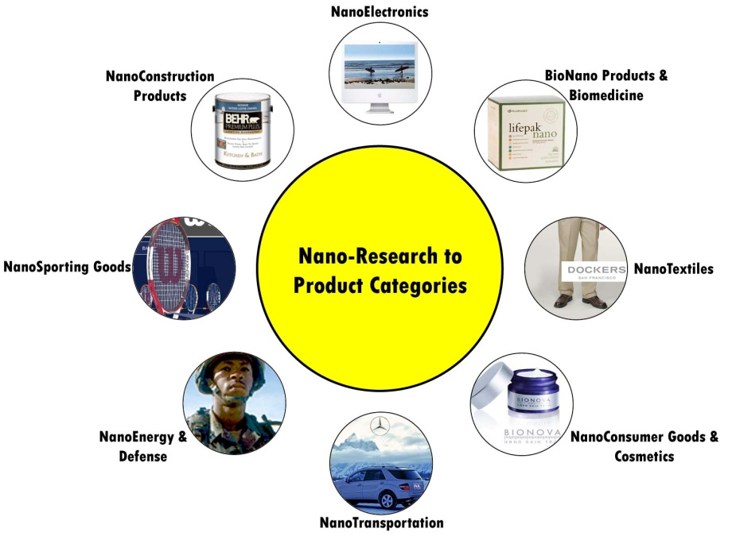
So many nanomaterials, so little understanding!
Over 2,800 pristine nanomaterials (NMs)¹ and numerous nanoproducts are already on the market
We have toxicity data for only a small number of them
Traditional mammalian tox testing for each NM is not practical
  Estimated $249 million to $1.18 billion for NM already on the market in 2009 (Choi et al 2009)
http://nrc.ien.gatech.edu/sites/default/files/NanoProductsPostercopy.jpg
Nanowerk. Nanomaterial Database Search. Available at: http://www.nanowerk.com/phpscripts/n_dbsearch.php. (Accessed July 26 2012)
Choi J-Y, Ramachandran G, Kandlikar M. The impact of toxicity testing costs on nanomaterial regulation. Environ Sci Technol 2009, 43:3030-3034.
Notes:
Wouldn’t it be nice to be able to forecast the toxicity? Or just know what NMs need to be throughly tested first?

Slide 3
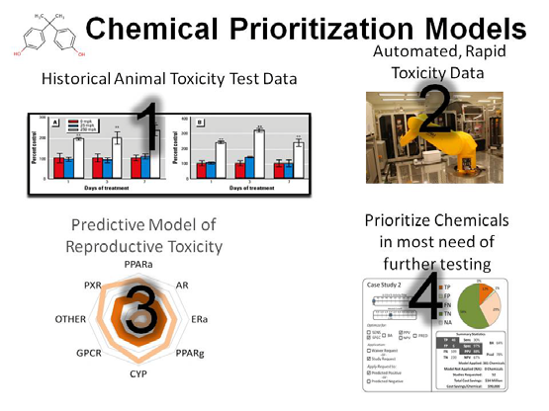
ToxCast™ - Toxicity Forecaster
Part of EPA’s computational toxicology research
High-throughput screening (HTS)
(
)

Slide 4
High-throughput screening (HTS) and computational models may be able to help to
Cost- and time-efficient screening of bioactivities
  Testing time in days.
  Characterize bioactivity
Identifying correlation between NM physicochemical properties and bioactivity
Prioritize research/hazard identification
  Extrapolate to NMs not screened
Notes:
For one compound, a two-generation reproductive toxicity study in rats is estimated to cost $500,000 to $750,000,¹⁸ and a developmental toxicity study is about one tenth of that, while the cost of HTS can be less than $ 0.5 per target per compound.¹⁹
^{Keith:} Just leave as an assumption of cheaper. could then answer a question, if posed, that single assay endpoints range from less than $1 to more than $100. Determining the specific assays required would be necessary to determine actual costs.

Slide 5




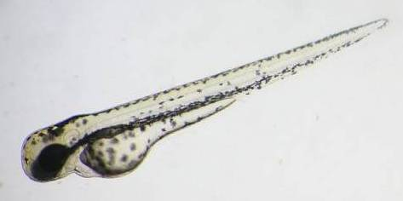
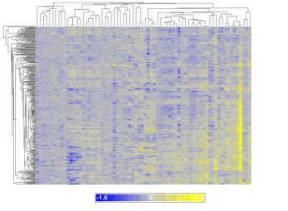
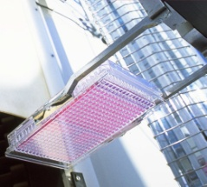
  NM testing in ToxCast
ENPRA
Goals:
  Identify key nanomaterial physico-chemical characteristics influencing its activities
  Characterize biological pathway activity
  Prioritize NMs for further research/hazard identification
>1000 chemicals; ~60 NMs (Ag, Au, TiO₂, SeO₂, ZnO, SiO₂, Cu, etc)
Physical chemical properties of NM
Profile
Matching
HTS assay
results
Notes:
Toxcast program
Based on high-throughput, in vitro assays to characterize bioactivity of compounds
Based in National Center for Computational Toxicology (NCCT), Office of Research and Development, US EPA
Addresses needs of Agency to prioritize for toxicity testing the thousands of chemicals on a variety of regulatory lists
Coordinated with NIH/NTP and NHGRI/NCGC via Tox21
Committed to stakeholder involvement and public release of data
Duke Center for the Environmental Implications of NanoTehcnology (CEINT)
National Toxicology Program (NTP)
NCGC – NIH (National Institutes of Health) Chemical Genocmics Center
Organisation for Economic Co-operation and Development (OECD)
Engineered NanoParticle Risk Assessment (ENPRA)

Slide 6
Current nano data in ToxCast
HTS of bioactivity completed for 70 samples (62 unique samples)
  6 to 10 concentrations
  Data are being analyzed
Characterization of NM physicochemical properties in progress
 | nano | micro | ion
Ag | √ | √ | √
_{Asbestos} |  | √
Au | √
SWCNT MWCNT | √
CeO₂ | √ | √ | √
Cu | √ |  | √
SiO₂ | √ | √
TiO₂ | √ | √
ZnO | √ | √ | √

Slide 7
Characterization data coverage
Endpoints | Method (by CEINT, unless specifiede) | Samples | As received |  | (Re)suspended
 |  |  | Dry material | Sus-pension | In stock (H₂O+serum) | In 4 testing mediums, 2 conc.(# of time points)
size distribution and shape | TEM, SEM, DLS, cytoviva | nano and micro | √ | √ | √ | √ (2)
surface area | BET (by NIOSH and NIST) | nano and micro | √ |  | √ | √ (3)
chemical composition | XRD, TOC | all samples | √ | √
crystal form | XRD | applicable samples | √ | √
purity | NIR, Raman | nano and micro | √ | √
total metal concentration |  | metallic samples |  |  | √ | √ (1)
total non-metal concentration |  | non-metallic samples |  |  | √
ion concentration | ICP-MS and others | applicable samples |  |  | √ | √ (3)
zeta potential, surface charge | zetasizer | nano and micro |  |  | √
Notes:
Chemical composition includes surface composition/contamination
Dec 26 2012 note: Not to test zeta potential in medium, because the high conductivity of the medium, all zeta potential measurement appeaer the same regardless materials or time points.

Slide 8

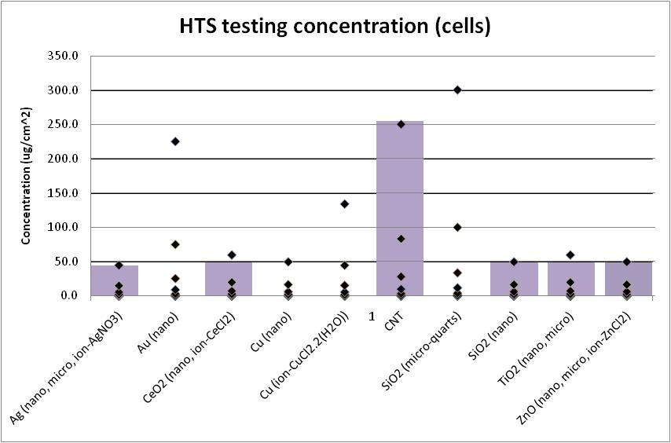
Determine testing conc. in cells
Reported potential occupational inhalation exposure
Estimated
lung retention
Conc.
(ug/cm²)
♦ Testing concentration
█ MPPD predicted lung retention of NM after 45 year exposure
Gangwal et al. Environ Health Perspect 2011 Nov;119(11):1539-46.
Notes:
For classes of nanomaterials across assays
Consider realistic exposure scenarios
No post-manufacturer wash or purification
No surfactants
Factors affecting nanomaterial dispersion
Sonication power and duration
Solution (water purity, serum, medium, etc)
Container shape
Compare protocols used: literature, EPA, Duke, ENPRA, OECD

Slide 9
HTS bioactivity coverage (1)
Transcription factor activation (Attagene)
DNA
RNA
Protein
Function/
Phenotype
Protein expression profile (BioSeek)
Cell growth kinetics (ACEA Bioscience)
Toxicity phenotype effects (Apredica)
Developmental malformation (EPA)
Notes:
Endpoint count
Attagene: only count CIS, not count TRANS
BioSeek: 174 (LEC or AC50) for both up and down. List 87 for endpoints.

Slide 10
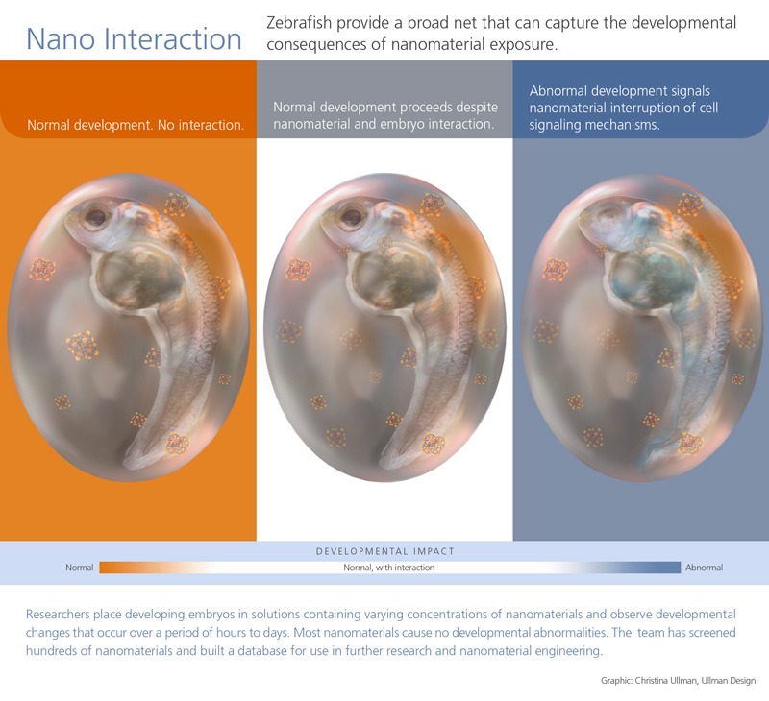
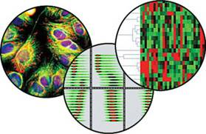
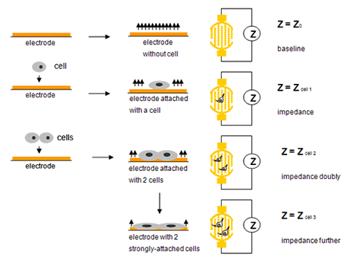
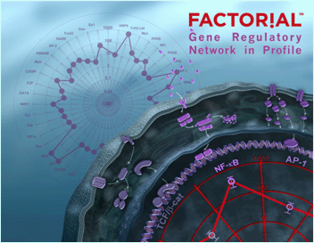
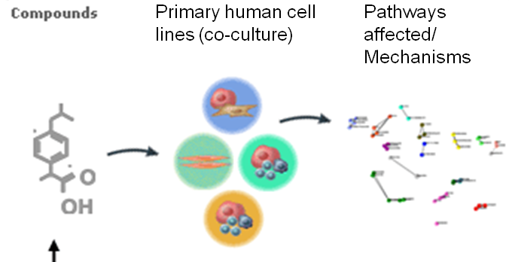
  Screening Tests
ACEA
Cellumen/Appredica
Zebrafish embryos
Attagene
Selected endpoints
  Effects on transcription factors in human cell lines (Attagene)
  Human cell growth kinetics (ACEA Biosciences)
  Protein expression profiles in complex primary human cell culture models (BioSeek/Asterand)
BioSeek
  Toxicity phenotype effects (DNA, mitochondria, lysosomes etc.) in human and rat liver cells through high-content screening/ fluorescent imaging (Cellumen/Apredica)
  Developmental effects in zebrafish embryos
Notes:
Duke Center for the Environmental Implications of NanoTehcnology (CEINT)
National Toxicology Program (NTP)
NCGC – NIH (National Institutes of Health) Chemical Genocmics Center
Organisation for Economic Co-operation and Development (OECD)
Engineered NanoParticle Risk Assessment (ENPRA)
http://dels.nas.edu/best/risk_analysis/Documents/Symposium%20Presentations%20Approved%20to%20Post/11%20Kavlovk.pdf
ToxCast Assays
(1) Biochemical Assays
Protein families
GPCR
NR
Kinase
Phosphatase
Protease
Other enzyme
Ion channel
Transporter
• Assay formats
Radioligand binding
Enzyme activity
Co-activator recruitment
(2) Cellular Assays
Cell lines
HepG2 human hepatoblastoma
A549 human lung carcinoma
HEK 293 human embryonic kidney
• Primary cells
Human endothelial cells
Human monocytes
Human keratinocytes
Human fibroblasts
Human proximal tubule kidney cells
Human small airway epithelial cells
• Biotransformation competent cells
Primary rat hepatocytes
Primary human hepatocytes
• Assay formats
Cytotoxicity
Reporter gene
Gene expression
Biomarker production
High-content imaging for cellular phenotype
ZSebrafish embryo
http://www.google.com/imgres?imgurl=http://oregonstate.edu/leadership/president/report/sites/default/files/nano_high_noon.jpg&imgrefurl=http://oregonstate.edu/leadership/president/report/2008/fall/high-noon-nano&usg=__De0MGAVMYkomxj5ZL4xNS-nZ4F0=&h=730&w=800&sz=158&hl=en&start=4&itbs=1&tbnid=qORAeG0FrX4p5M:&tbnh=130&tbnw=143&prev=/images%3Fq%3Ddevelopmental%2Bzebrafish%2Bembryo*%2Bnano*%26hl%3Den%26sa%3DN%26tbo%3D1%26rls%3Dcom.microsoft:*:IE-SearchBox%26imgsz%3Dm%26imgtbs%3Dz%26ndsp%3D20%26tbs%3Disch:1

Slide 11
Cells used in the HTS
Main type of result by assay platform | Primary/ cell line | Species | Cell type
Transcription factor activation | Cell line | Human | Hepatocytes (HepG2)
Protein expression profile | Primary | Human | Umbilical vein endothelial cells (HUVEC), HUVEC+Peripheral blood mononuclear cells Bronchial epithelial cells Coronary arterial smooth muscle cells Dermal fibroblasts-neonatal (HDFn) Epidermal keratinocytes + HDFn
Cell growth kinetics | Cell line | Human | Lung (A549)
Toxicity phenotype | Primary Cell line | Rat Human | Hepatocytes Hepatocytes (HepG2)
Developmental malformation | NA | Zebrafish | embryos
Notes:
Endpoint count
Attagene: only count CIS, not count TRANS
BioSeek: 174 (LEC or AC50) for both up and down. List 87 for endpoints.

Slide 12
HTS bioactivity coverage (2)
Main type of result by assay platform | # of endpoint measured | # of direction (time points) | # of potential LEC/ AC50 per NM per conc.
Transcription factor activation | 48 | NA | 48
Protein profile | 87 | 2 | 174
Cell growth kinetics | 1 | 2 (numerous) | 2 x time points selected
Toxicity phenotype | 19 | NA (2) | 38
Developmental malformation | Aggregated to 4 | NA | 4
Transcription factor activation, 48 endpoints (Attagene)
DNA
RNA
Protein
Function/
Phenotype
Total > 266
Notes:
Endpoint count
Attagene: only count CIS, not count TRANS
BioSeek: 174 (LEC or AC50) for both up and down. List 87 for endpoints.

Slide 13
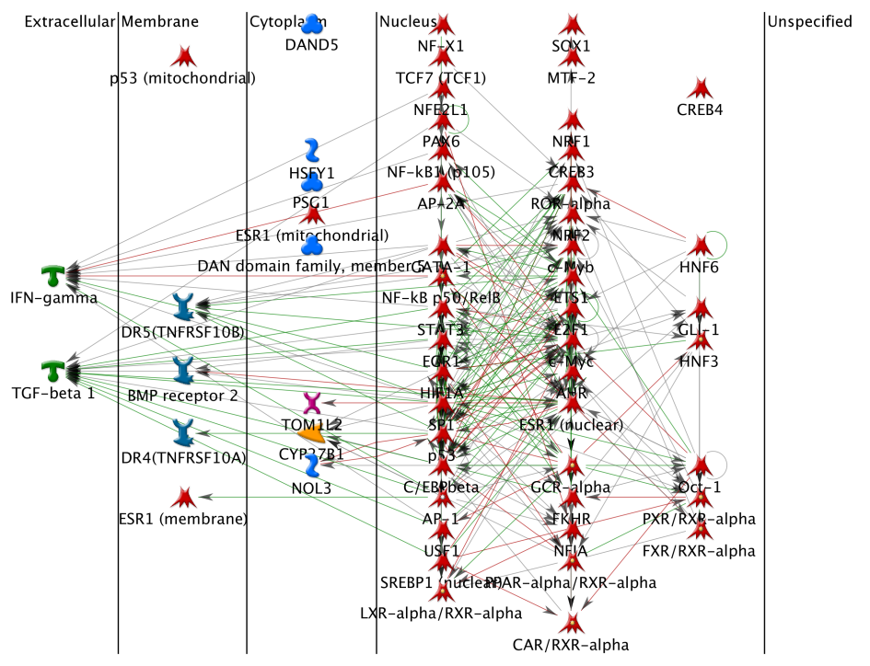
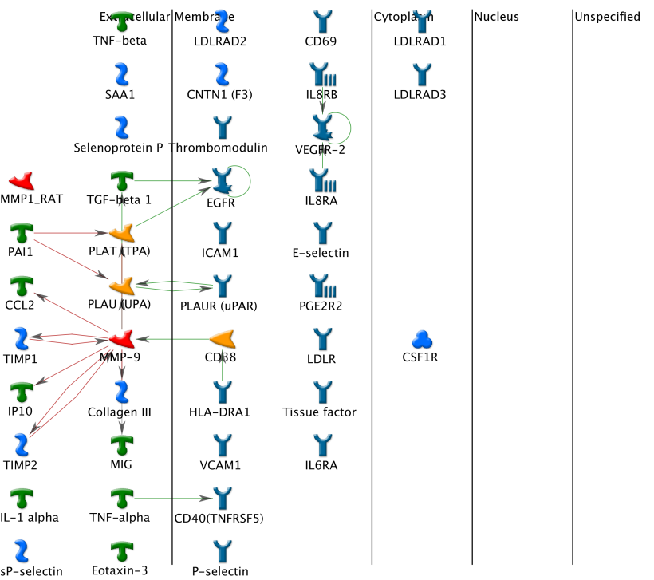
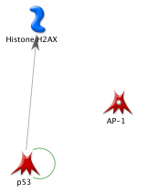
Bioactivity endpoints related to genes
Transcription factor
activation (Attagene)
Toxicity phenotype (Apredica)
Protein expression profile (BioSeek)

Slide 14
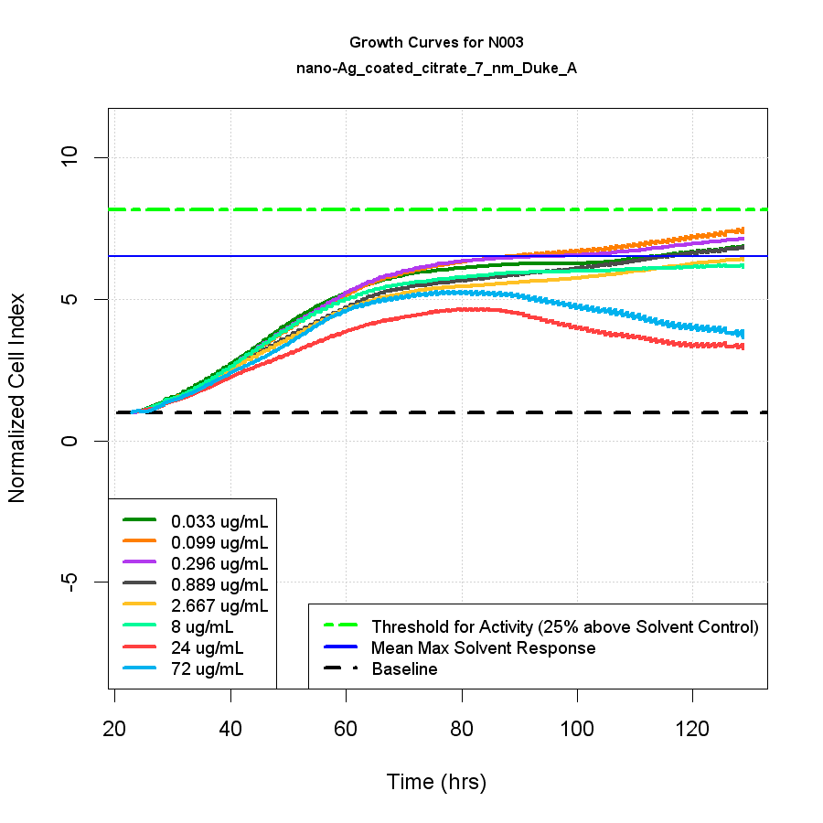
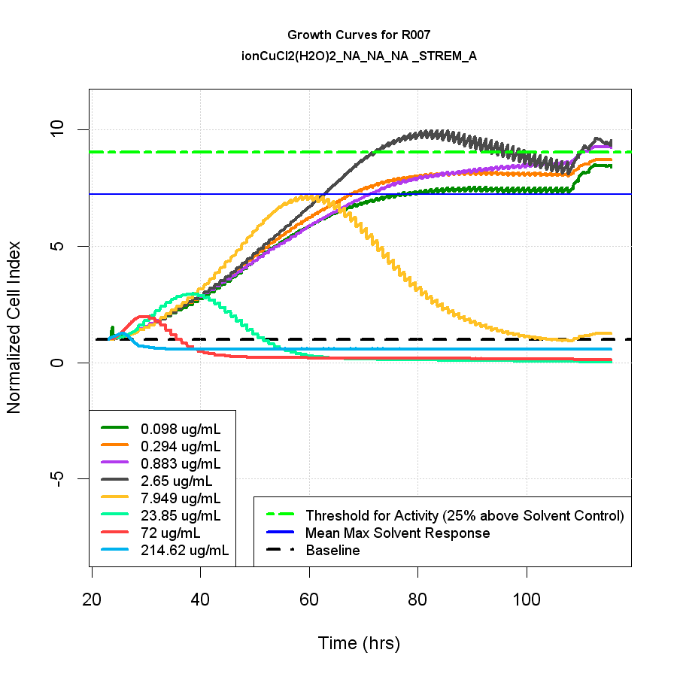
Endpoints not mapped to genes
Cytotoxity in various assays
Cell growth kinetics (ACEA)
Toxicity phenotype: lysosomal mass, apoptosis, DNA texture, ER stress/DNA damage, steatosis, etc. (Apredica)
Notes:
Select time points to calculate AC50/LEC

Slide 15
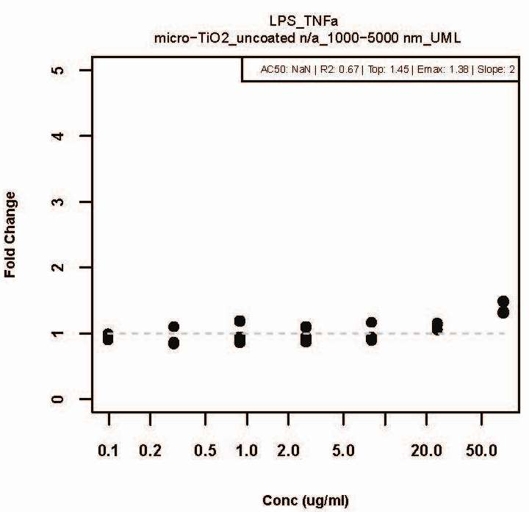
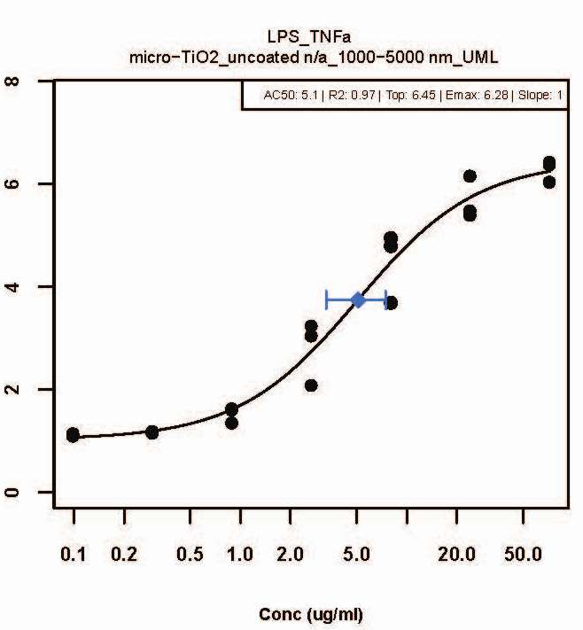
Calculated LEC and AC50 from dose-response curve
Emax
AC50
LEC
Notes:
Do the same for decrease.
Add another example of cytotox to be filtered out at high end conc?

Slide 16
Data are standardized and stored in EPA internal database - ToxCastDB
Emax
AC50
LEC
sample_rep_id | BSK_sample_ID | chemical_id | chemical_name | Test_Mat | assay_name | LEC | AC50 | Emax
NT-N008-00013-1 | NT-N008-00013-1-04_1 | NT-N008-00013-1-04 | nano-CeO2_uncoated n/a_70 -105 nm_OECD | N008_nano-CeO2_uncoated n/a_70 -105 nm_OECD | CASMC_HCL_IL-1b_TNF-a_IFN-g_24.CD106_VCAM-1 | 29 | 31 | 1.18
NT-M007-00015-1 | NT-M007-00015-1-04_1 | NT-M007-00015-1-04 | micro-CeO2_n/a n/a_n/a nm_Sigma | M007_micro-CeO2_n/a n/a_n/a nm_Sigma | CASMC_HCL_IL-1b_TNF-a_IFN-g_24.IL-6 | 3.7 | 4.5 | 1.47
NT-M007-00015-1 | NT-M007-00015-1-04_2 | NT-M007-00015-1-04 | micro-CeO2_n/a n/a_n/a nm_Sigma | M007_micro-CeO2_n/a n/a_n/a nm_Sigma | CASMC_HCL_IL-1b_TNF-a_IFN-g_24.IL-6 | 11 | 14 | 1.55
NT-M007-00015-1 | NT-M007-00015-1-04_3 | NT-M007-00015-1-04 | micro-CeO2_n/a n/a_n/a nm_Sigma | M007_micro-CeO2_n/a n/a_n/a nm_Sigma | CASMC_HCL_IL-1b_TNF-a_IFN-g_24.IL-6 | 0.07 | 0.07 | 1.48
NT-N008-00013-1 | NT-N008-00013-1-04_1 | NT-N008-00013-1-04 | nano-CeO2_uncoated n/a_70 -105 nm_OECD | N008_nano-CeO2_uncoated n/a_70 -105 nm_OECD | CASMC_HCL_IL-1b_TNF-a_IFN-g_24.IL-6 | 11 | 15 | 1.63
NT-N008-00013-1 | NT-N008-00013-1-04_2 | NT-N008-00013-1-04 | nano-CeO2_uncoated n/a_70 -105 nm_OECD | N008_nano-CeO2_uncoated n/a_70 -105 nm_OECD | CASMC_HCL_IL-1b_TNF-a_IFN-g_24.IL-6 | 25 | 28 | 1.53
NT-N009-00014-1 | NT-N009-00014-1-04_1 | NT-N009-00014-1-04 | nano-CeO2_uncoated n/a_15 - 30 nm_OECD | N009_nano-CeO2_uncoated n/a_15 - 30 nm_OECD | CASMC_HCL_IL-1b_TNF-a_IFN-g_24.IL-6 | 17 | 21 | 1.71
NT-N009-00014-1 | NT-N009-00014-1-04_2 | NT-N009-00014-1-04 | nano-CeO2_uncoated n/a_15 - 30 nm_OECD | N009_nano-CeO2_uncoated n/a_15 - 30 nm_OECD | CASMC_HCL_IL-1b_TNF-a_IFN-g_24.IL-6 | 12 | 15 | 1.58
NT-N009-00014-1 | NT-N009-00014-1-04_3 | NT-N009-00014-1-04 | nano-CeO2_uncoated n/a_15 - 30 nm_OECD | N009_nano-CeO2_uncoated n/a_15 - 30 nm_OECD | CASMC_HCL_IL-1b_TNF-a_IFN-g_24.IL-6 | 15 | 19 | 1.48
Notes:
show a level 6 or 7 file format and point this to ToxCastDB to show data is standardized and stored in internal database.

Slide 17
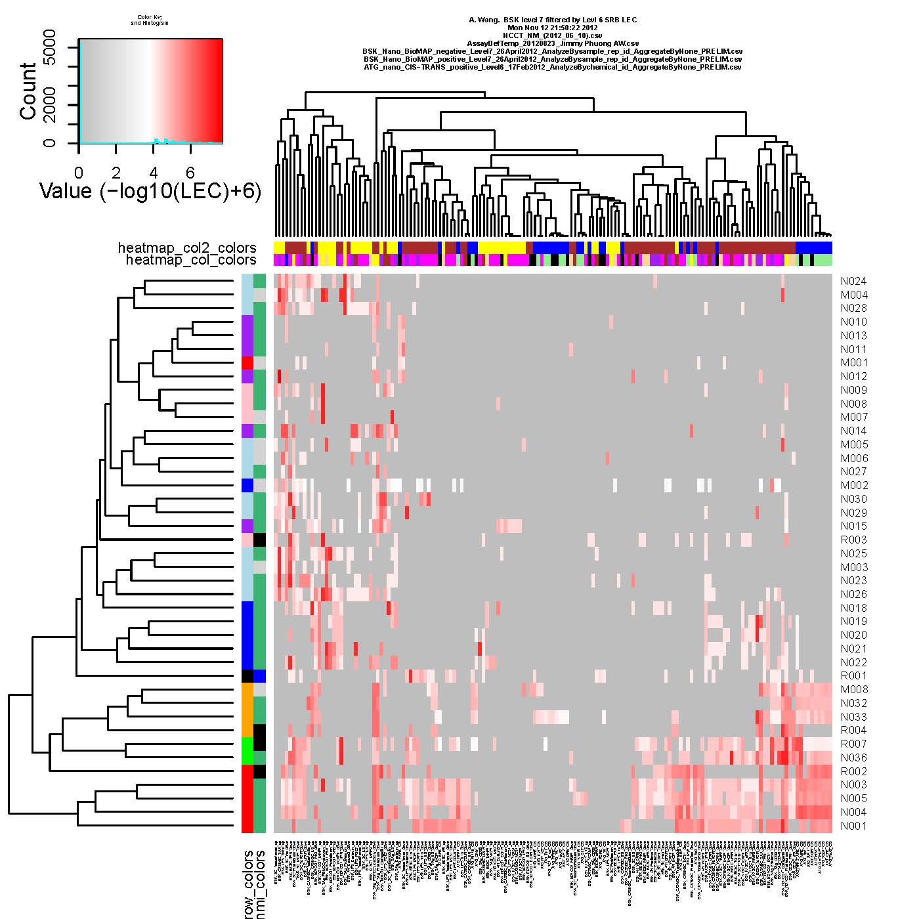
PRELIMINARY results
high promiscuity was coupled with high potency
Notes:
Filtered out cytotoxic effects
(LEC < 1/9 of cytotox LEC)
We ranked samples by promiscuity (the number of assays affected) and potency. Both ranking methods produced very similar results and high promiscuity was coupled with high potency. Ag, Cu, and Zn samples were ranked highest priority for further testing.

Slide 18
Summary of strengths in data set
Consistent handling protocol, including dispersion/stock preparation
Testing concentrations related to exposure condition, and each assay has >= 6 conc. to generate a dose-response curve
HTS provides extensive coverage in bioactivities
Good characterization coverage, including as received materials, in stock and testing mediums

Slide 19
Summary of challenges
Characterization of NM physicochemical properties is limited by available technology and time
Testing materials were not selected specific for testing structure-activity relationship
Assay predicting power is unknown
  For predicting chronic effects: most assays are 24 hr exposure
  Assay model may not be appropriate: E.g. Lung effects may depend on macrophages phagocytizing NMs
  Very limited in vivo data available
Notes:
Characterization –
For instance, surface charge or zeta potential is an important factor in predicting suspension stability, aggregate/agglomerate sizes, etc. Ideally, knowing zeta potential of NM in testing mediums will give us a better idea of what cells would be exposed to (than NM in stock). However, zeta potential of NM in testing medium cannot be accurately measured, due to high electron conductivity of the medium.
Characterization also takes more time than the screening of bioacivitities.
Not for SAR-
For instance, most materials were not coated.

Slide 20
Summary of preliminary results
NMs are compatible with most HTS and HCS assays
NMs that were active in more assays (more promiscuous) tend to induce biological changes at lower concentrations (more potent)
  As a first-step prioritization method
Higher priority for further testing
more potent
more promiscuous
Notes:
Only one platform was discontinued due to frequent inference from ENMs to signals.
Use different detection methods for the same biological effect to help control potential confounds
more promiscuous and
active nanomaterials
(e.g., Ag, Cu, ZnO)
would be a higher priority for further testing
than less promiscuous and less active ones
(e.g., CeO₂, SiO₂, TiO₂, CNT etc)

Slide 21
Acknowledgments
Duke University, Center for the Environmental Implications of NanoTechnology (CEINT)
  Stella Marinakos
  Appala Raju Badireddy
  Mark Wiesner
  Mariah Arnold
  Richard Di Giulio
Baylor University
  Cole Matson
University of Massachusetts Lowell
  Gene Rogers
  ENPRA
  Lang Tran
  Keld Astrup Jensen
  OECD
  Christoph Klein
  Xanofi Inc
  Sumit Gangwal
EPA
National Center for Computational Toxicology
  Keith Houck
  Samantha Frady
  Elaine Cohen Hubal
  James Rabinowitz
  Kevin Crofton
  David Dix
  Bob Kavlock
  Woodrow Setzer
  ToxCast team
National Center for Environmental Assessment
  Mike Davis (J Michael Davis)
  Jim Brown
  Christy Powers
National Health and Environmental Effects Research Laboratory
  Stephanie Padilla
  Will Boyes
  Carl Blackman
  National Risk Management Research Laboratory
  Thabet Tolaymat
  Amro El Badawy
20

