Slide 1
Application of PCP in Drying Down UHP Gas Distribution Systems and Tools
Customized Project, Sponsored by Intel
Co- PIs:
Farhang Shadman, Chem and Environ Eng, UA
Carl Geisert, Sr. Principal Engineer, Intel
Graduate Students:
Jivaan Kishore: Ph.D. student, Chem Eng, UA
Undergraduate Students:
Andrew Jimenez, Chem and Environ Eng, UA

Slide 2
Objective
Develop techniques for reducing UHP gas usage in fabs:
Novel purge methods to remove contaminants during steady operation, start-ups, or recovery from system upsets.
Motivation and ESH Impact
Contamination of gas distribution systems during operation or at start-up results in wasting of expensive UHP gases and valuable tool operation time.

Slide 3
Experiment Testbed
Flow-restrictor (optional)
P
Gas Delivery System
P
2-way Valve
MFC 4
APIMS
CRDS
LaserTrace
B
Analyzers
Moisture Permeation Tube
MFC 3
A
C
MFC 2
Simulated process tool (interchangeable)
Capped lateral (interchangeable)
Vented lateral w/ orifice (interchangeable)
Houseline N₂
Multistage Gas
Purifier System
Gas distribution systems with different sizes and geometries were fabricated and provided by Intel
CRDS: high ppt – low ppm
APIMS: low ppt – low ppb

Slide 4
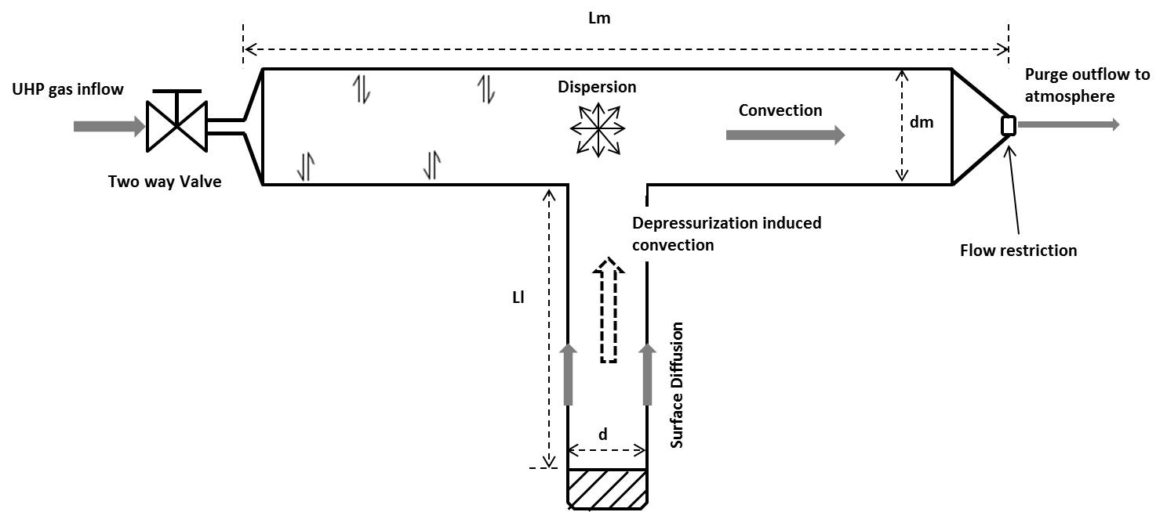
Comprehensive Simulator
Continuity equation:
Momentum balance:
$$\frac{∂Aρ}{∂t}+∇∙\left(Aρu\right)=0$$
$$ρ\frac{∂u}{∂x}=−∇P−f_{D}\frac{ρ}{2d_{h}}u\left|u\right|$$
Moisture concentration on the pipe surface:
$$\frac{∂C_{s}}{∂t}=∇.\left(D_{s}∇C_{s}\right)+k_{d}C_{s}−k_{a}C_{g}\left(S_{0}−C_{s}\right)$$
Surface Diffusion
Adsorption and desorption
Moisture concentration in the gas phase:
$$\frac{∂C_{g}}{∂t}+A∇.\left(uC_{g}\right)=∇.\left(AD_{e}∇C_{g}\right)+\frac{4}{d}\left[\left(k_{d}C_{s}−k_{a}C_{g}\left(S_{0}−C_{s}\right)\right)\right]$$
Convection
Diffusion
Adsorption and desorption

Slide 5
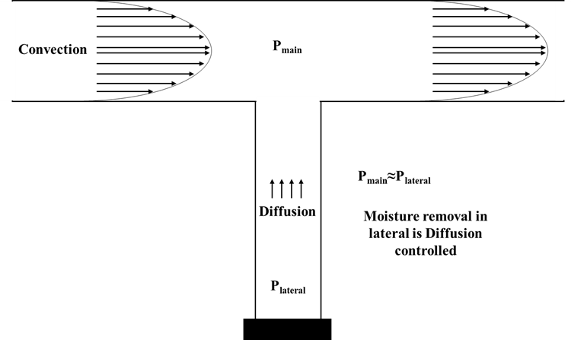
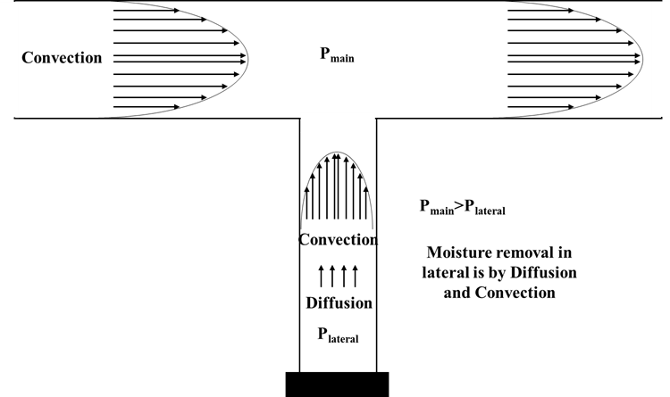
Purge Techniques
Steady State Purge (SSP)
SSP
High Pressure
Pressure
Purge Time
Pressure Cycle Purge (PCP)
SSP
DP
RP
DP
RP
DP
RP
SSP
High Pressure
Pressure
Low Pressure
Purge Time

Slide 6
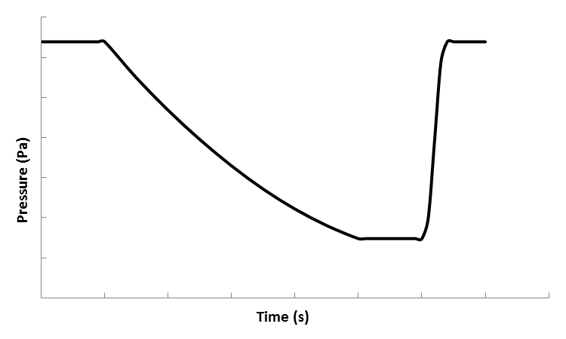
Example for Application of PCP:
Dry-Down of a Tool Chamber
Parameters of EPSS distribution line
Length of Main | 5 m
Length of Lateral | 1 m
Purge gas concentration | 0.2ppb
Initial surface concentration | 1E-6 mol/m^2
Surface capacity | 1.06E-6 mol/m^2
Lower operating pressure | 148000 Pa
Higher operating pressure | 640000 Pa
Time in low-pressure stage | 10 s
Time in high-pressure stage | 15 s
Depressurization time | 40 s
Adsorption rate constant | 500 m^3/(mol*s)
Desorption rate constant | 0.05 1/s
Orifice loss coefficient | 1E6
Main section
Lateral
Pressure (Pa)
Time (s)
Valve close
Valve open
Valve open
(reduced flow rate)

Slide 7
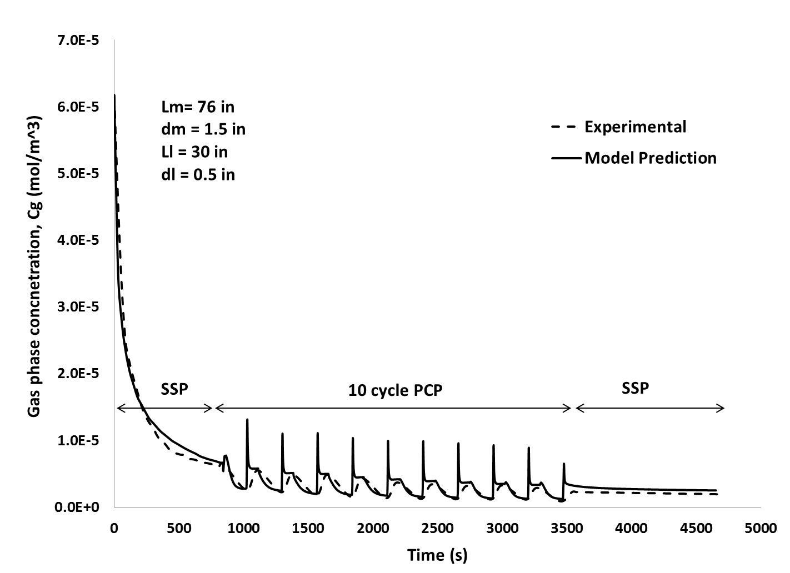
Simulator Validation

Slide 8
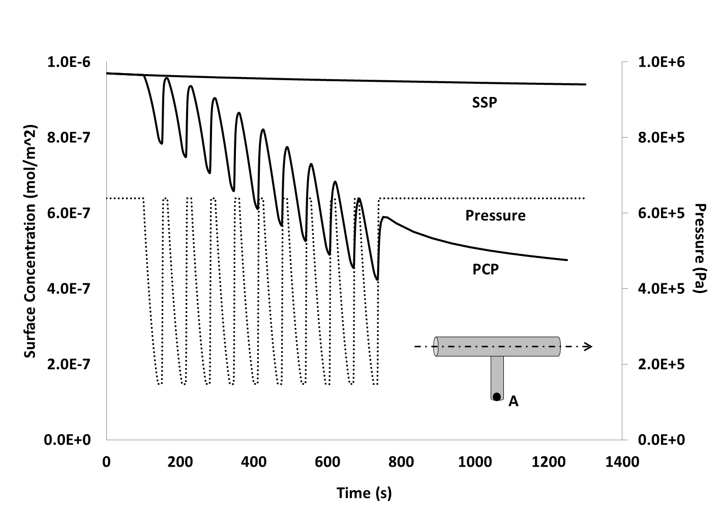
Surface Cleaning – PCP vs SSP

Slide 9
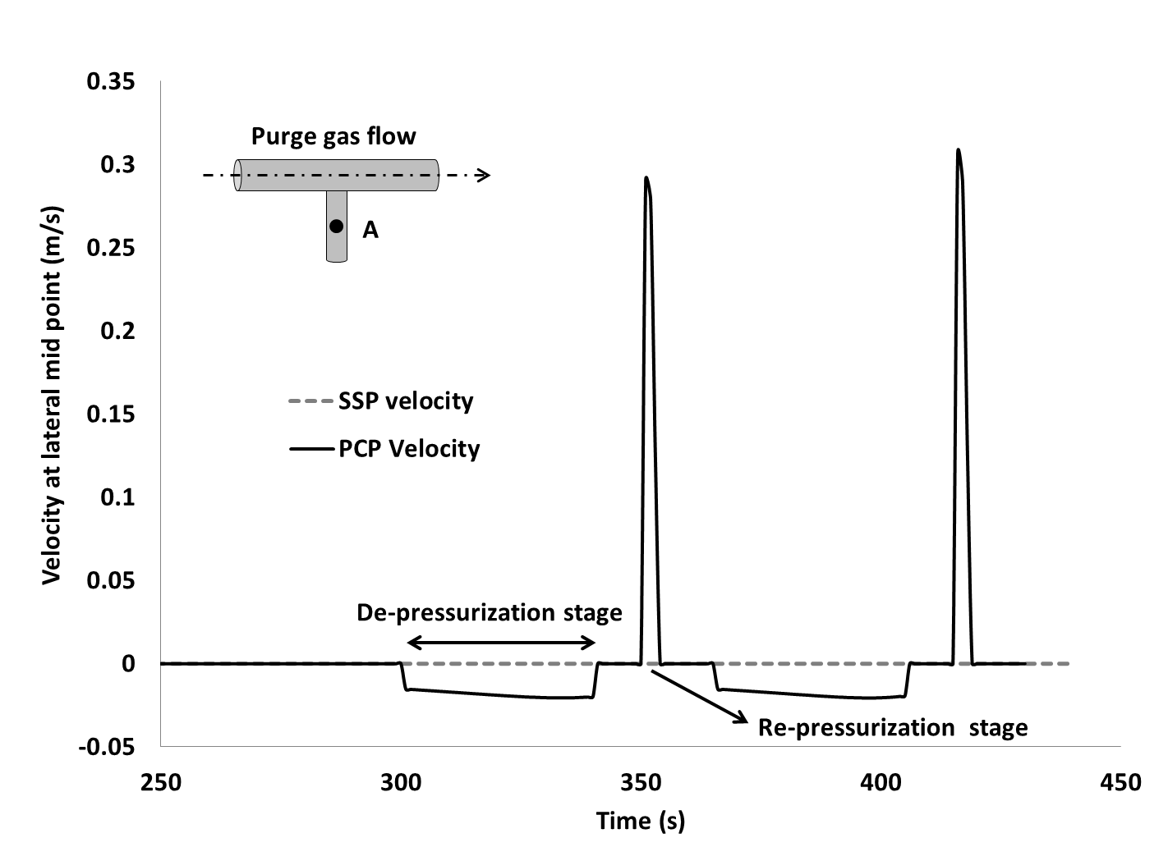
Velocity profile – PCP vs SSP

Slide 10
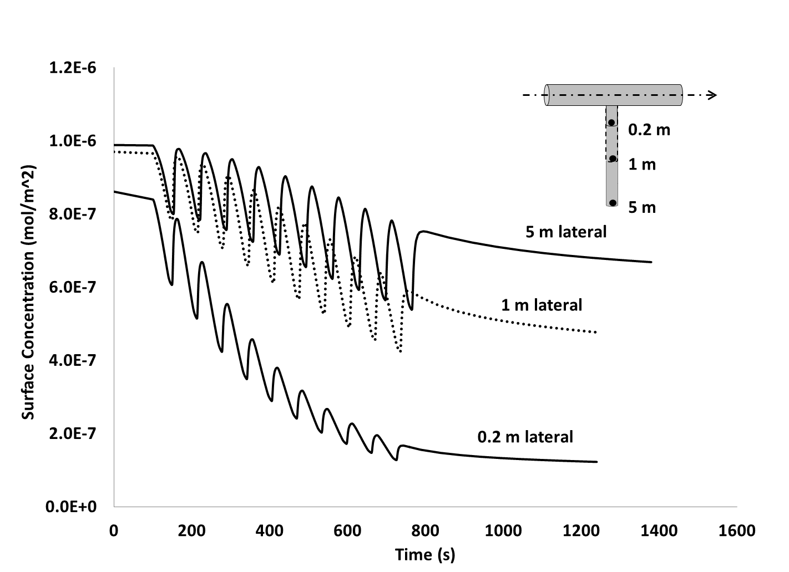
Dry Down Comparison of Varying Lateral Lenghts

Slide 11
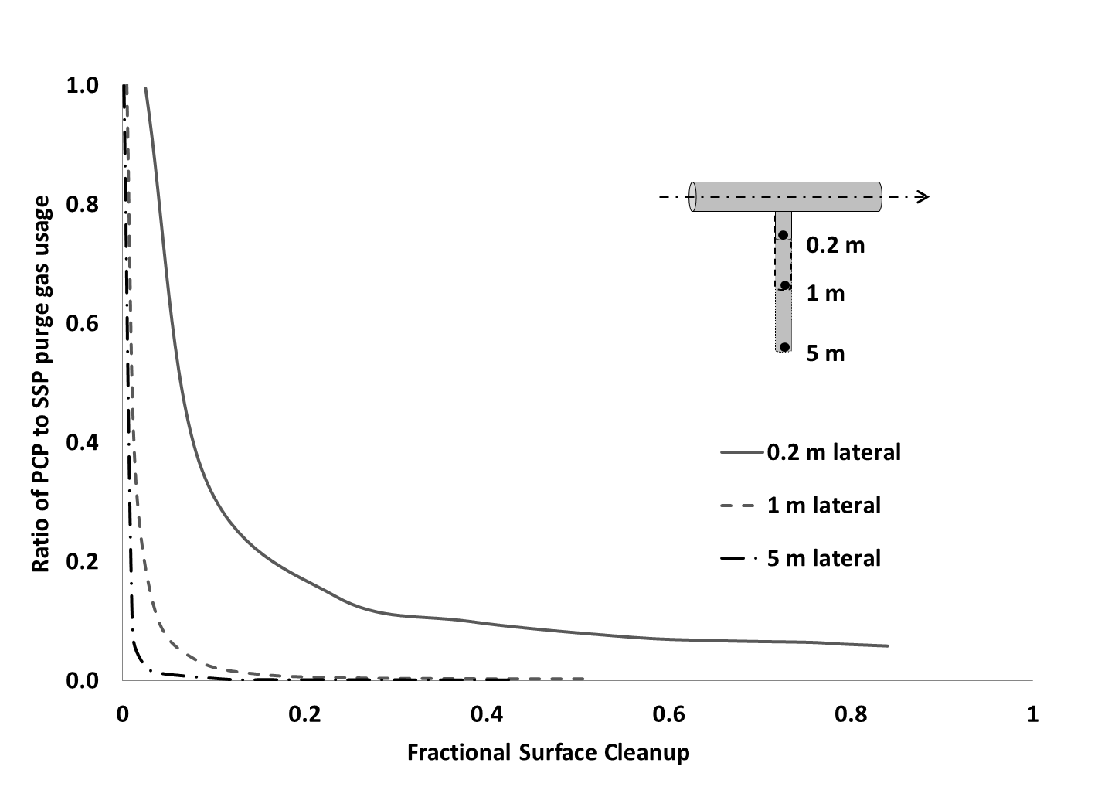
Purge Gas Saving with PCP

Slide 12
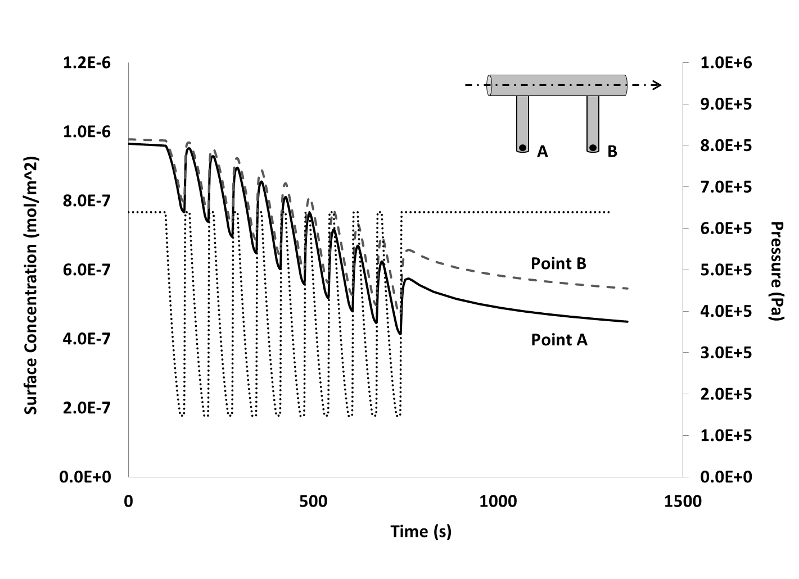
Purging of Multiple Dead Volumes

Slide 13
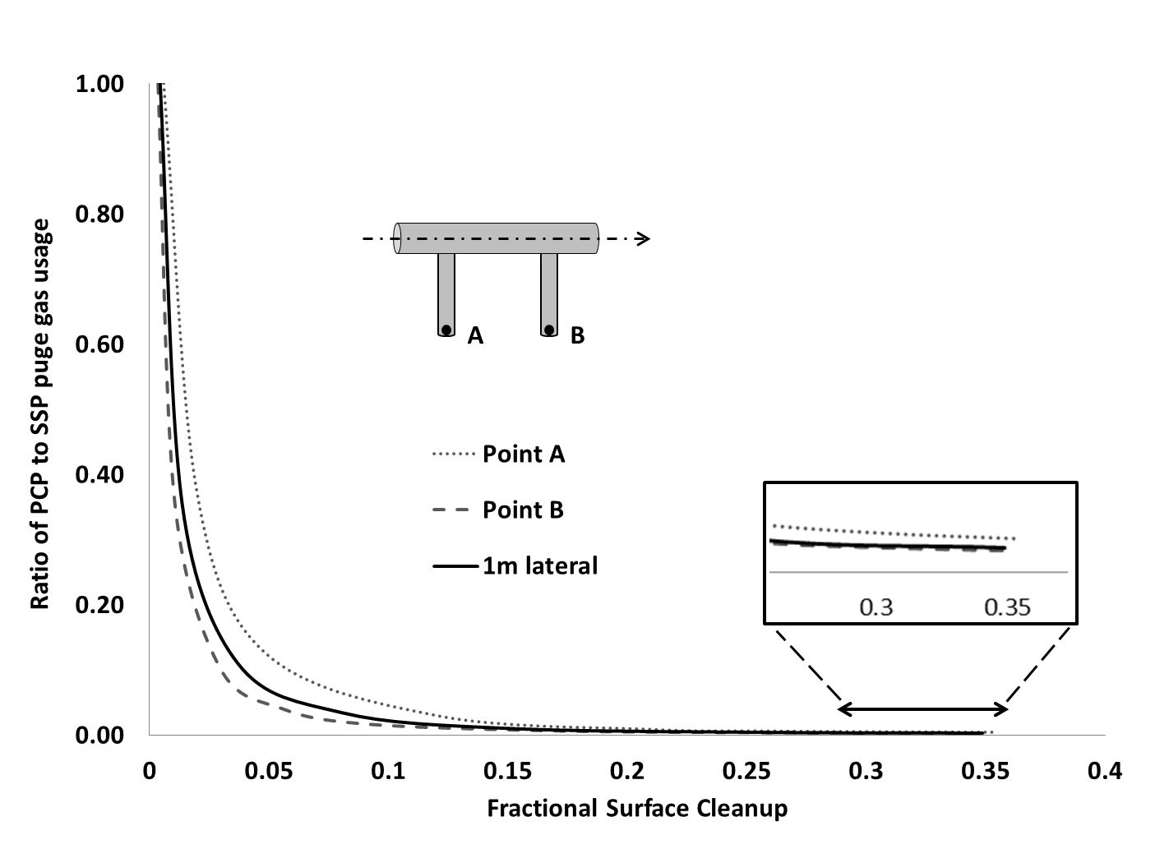
Purge Gas Savings with System Complexity

Slide 14
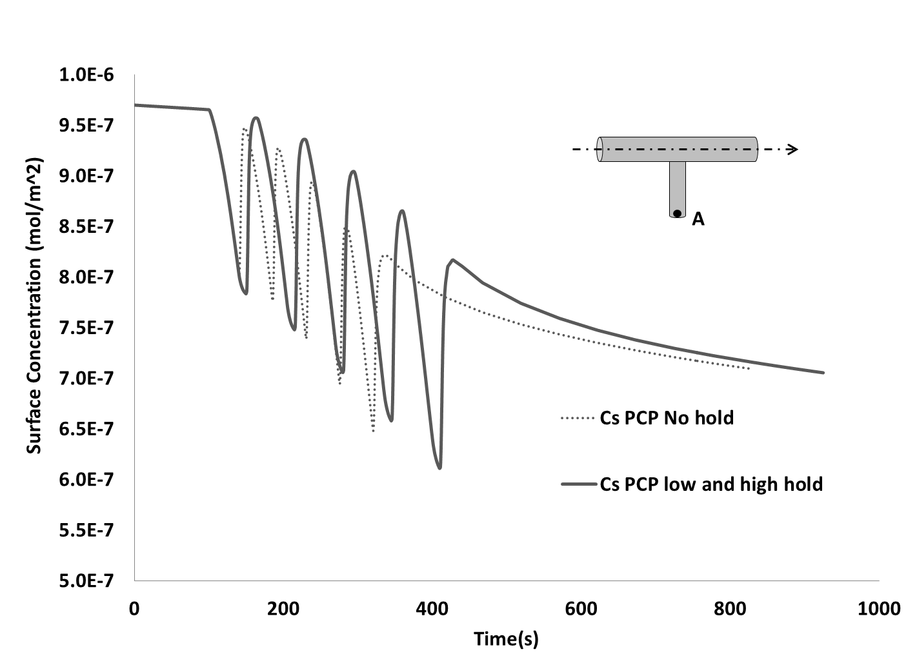
Effect of Holding Times on Purge Rate

Slide 15
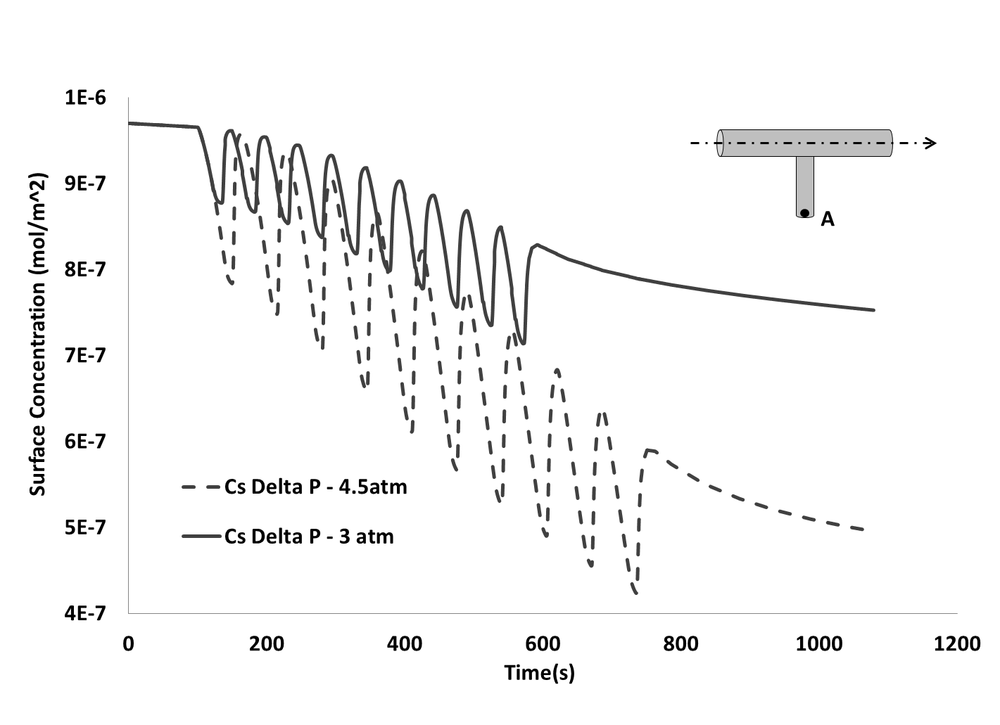
Effect of Operating Pressure Range on Cyclic Purge

Slide 16
Pressure Cyclic Purge (PCP) for Purging Tool Chambers
Purging tool chambers (outgassing and removal of adsorbed impurities such as moisture) is a major user of expensive UHP gases and other resources.
Lower Gas Usage + Lower Down Time
Means
ESH Gain + Lower Cost

Slide 17
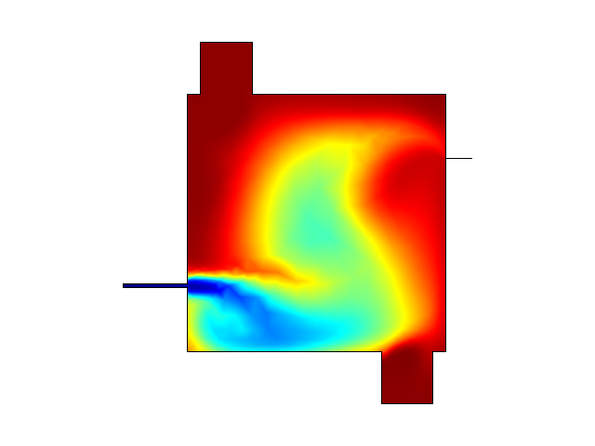
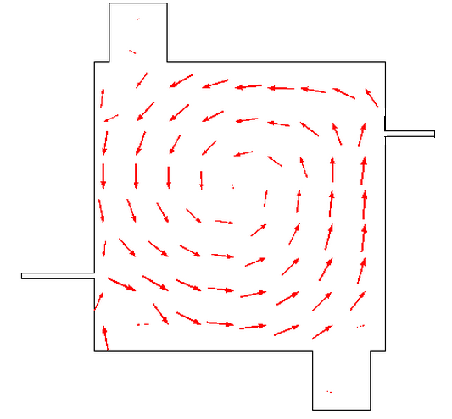
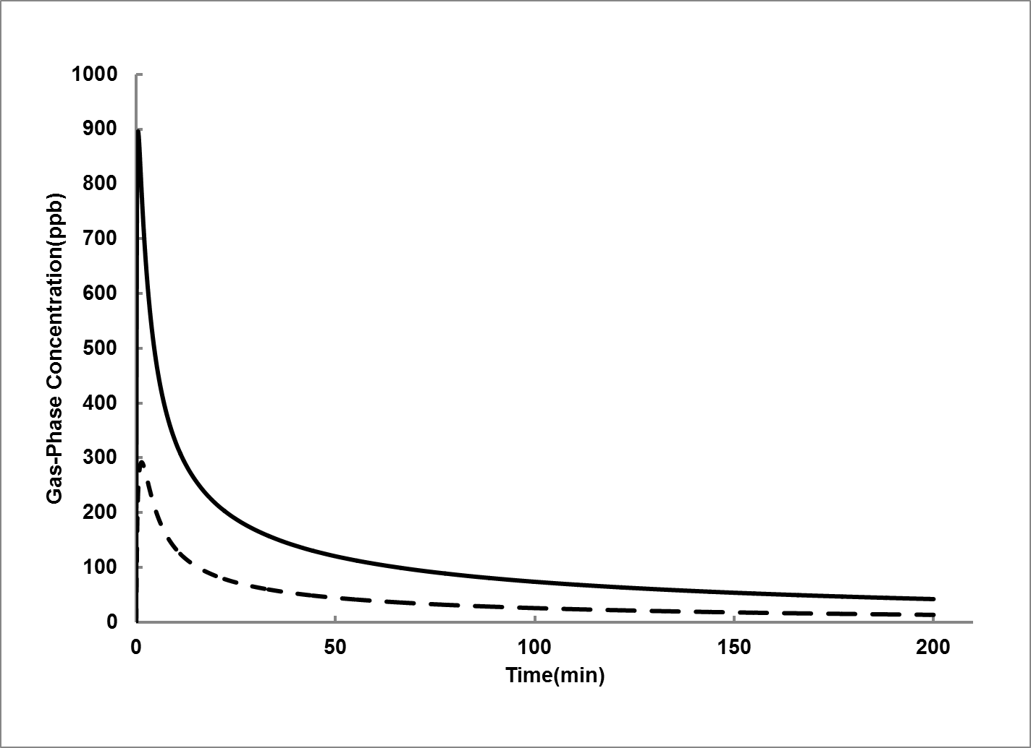
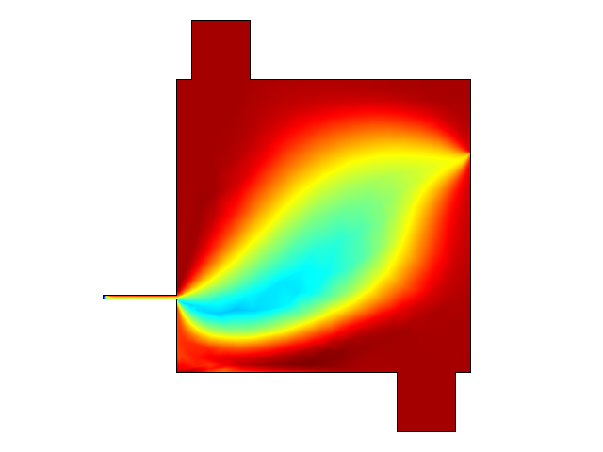
Conventional Steady State Purge (SSP)
SSP Flow Pattern
Point B
Point A
Darker regions: High concentration
Point B
Point A

Slide 18
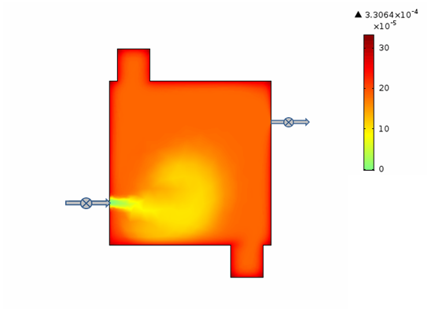
Conventional Steady State Purge (SSP)

Slide 19
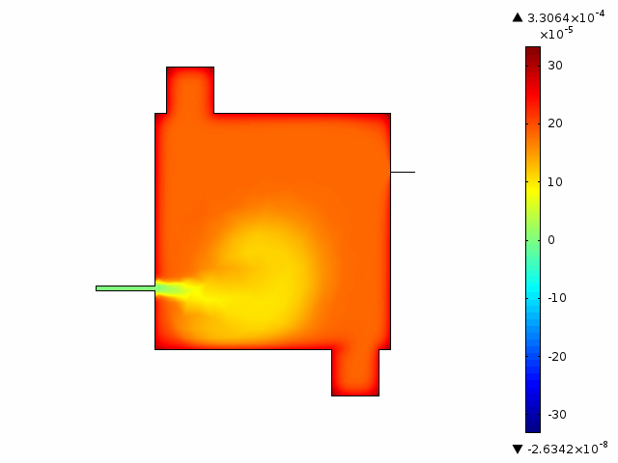
Conventional Steady State Purge (SSP)

Slide 20
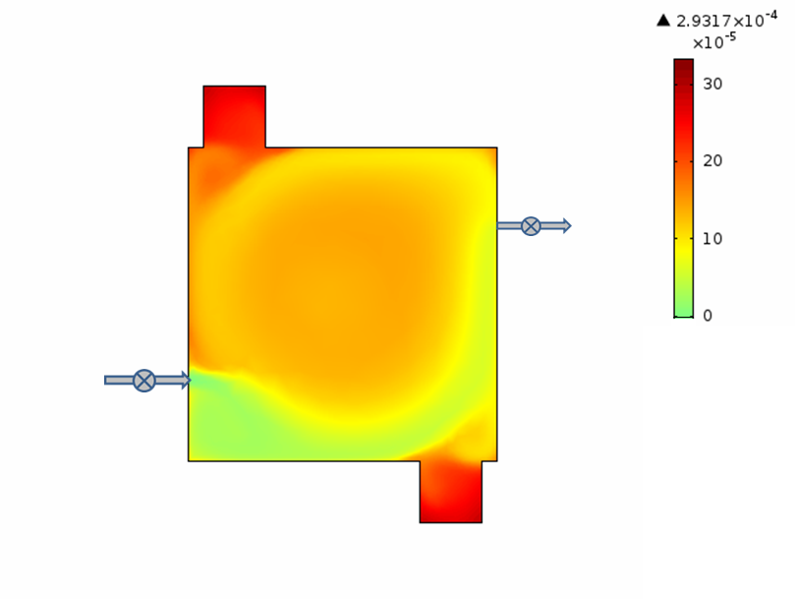
Conventional Steady State Purge (SSP)

Slide 21
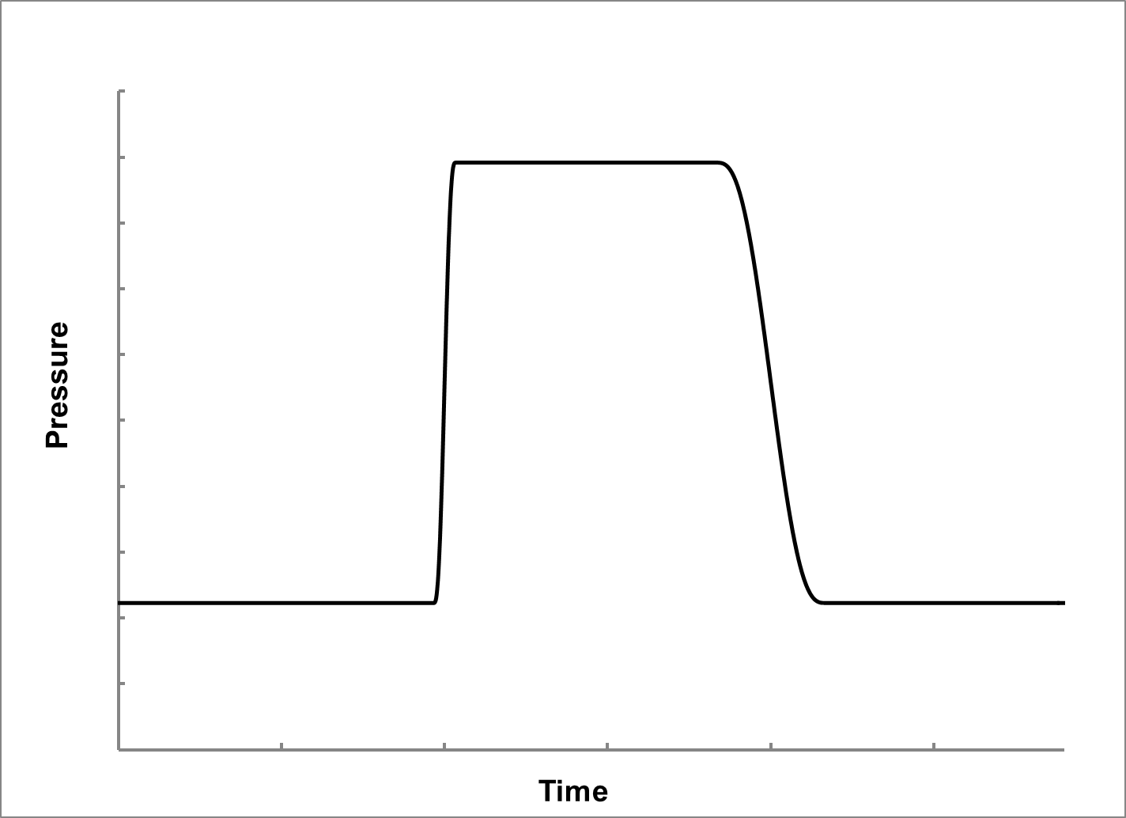
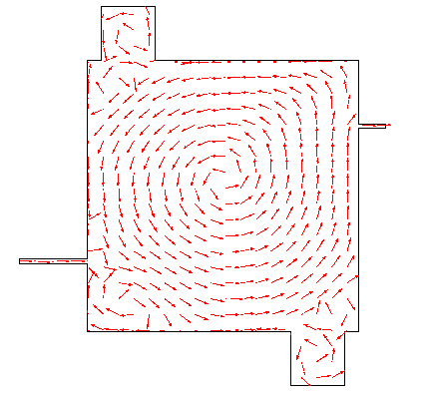
Pressure Cyclic Purge (PCP)
PCP-induced
convection in dead spaces
P_{high}
Valve B
Valve A
P_{low}
Velocity vectors
during PCP depressurization
A closed
B closed
A closed
B closed
A open
B closed
A closed
B open

Slide 22
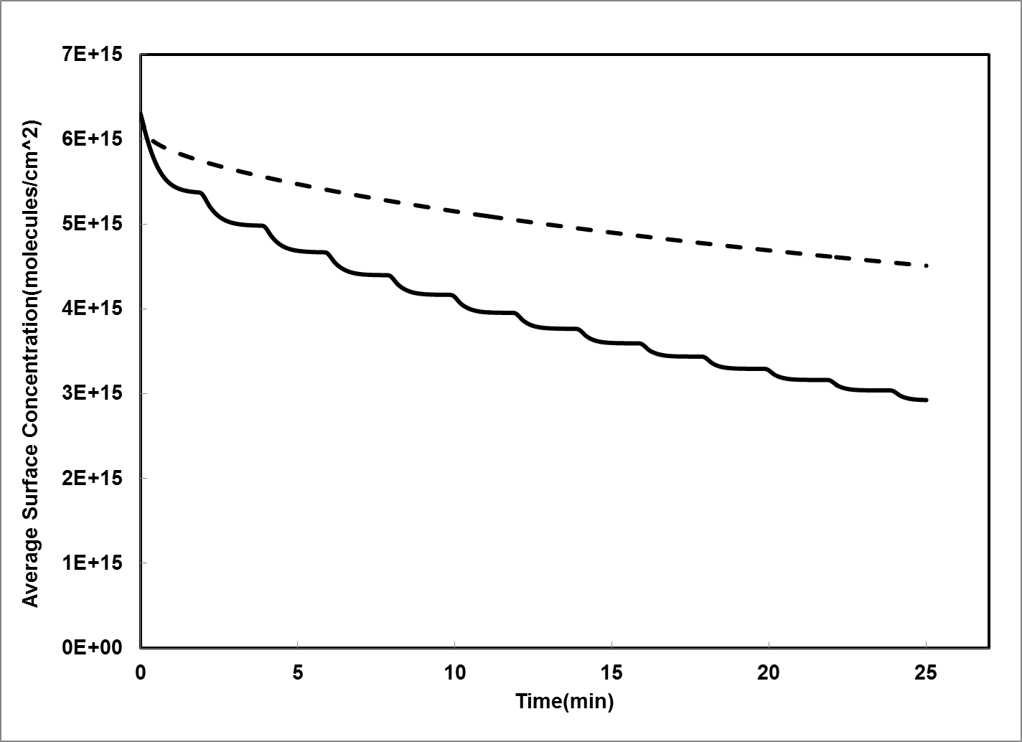
Overall Chamber Cleaning Profiles
SSP
Average Surface Concentration (molecules/cm²)
PCP
Time (min)

Slide 23
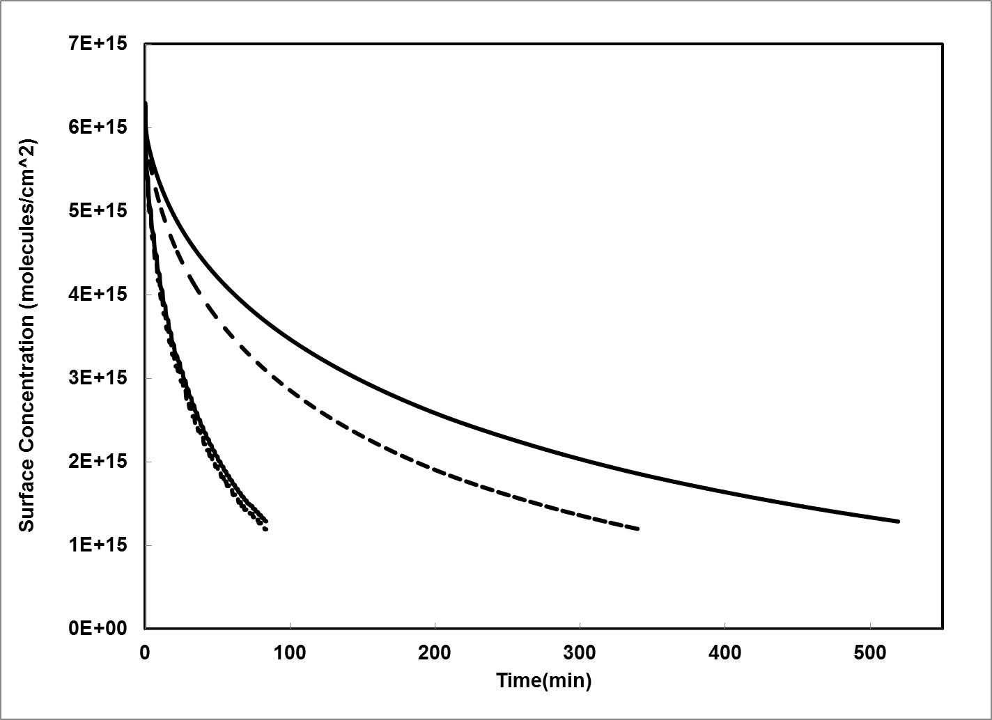
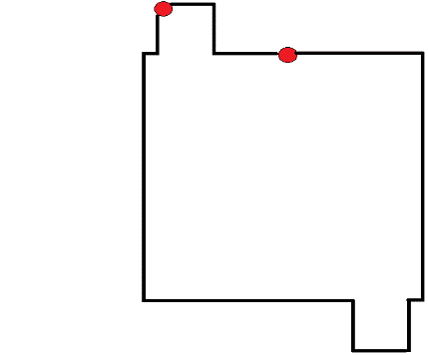
Surface Cleaning: PCP vs SSP
Point B
B
A
Point A
B
A
B
A
SSP
PCP
1.19E15 molecules/cm²
(Equilibrium gas-phase concentration = 15ppb)
Time (min)

Slide 24
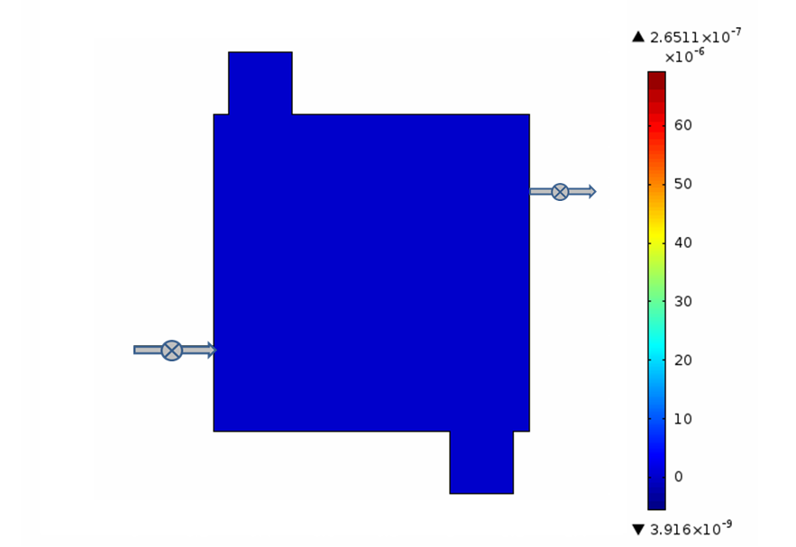
PCP Simulation
PCP Concentration Map

Slide 25
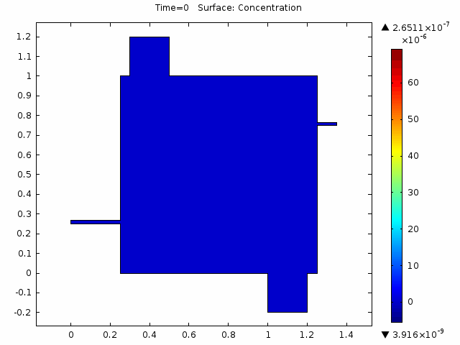
PCP Simulation
PCP Concentration Map
PCP Concentration Map
LOW PRESSURE STAGE
Desoption from walls
LOW PRESSURE STAGE
DESOPRTION
HIGH PRESSURE STAGE
VENTING

Slide 26
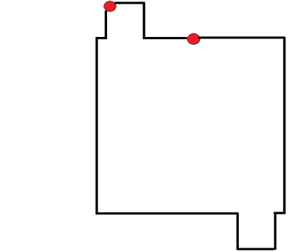
Purge Time Saving by PCP
Target concentration: 1.19E15 molecules/cm²
B
Point B
A
Point A

Slide 27
Summary and Conclusions
A combination of experiments and process modelling was used to study the application of pressure cycling purge of gas distribution lines and system tools
The basis of the cleaning effect of PCP is identified as the induction of a beneficial convective flow in regions that do not see flow during conventional SSP purge.
Higher benefit of PCP over conventional SSP is realized with increasing system complexity and system size
Purge time and purge gas usage required to achieve a certain overall system cleanliness significantly reduces as a more stringent target concentration is desired
The process simulator can be used both for design and purging of a new gas distribution networks as well as for the efficient operation and dry-down of existing systems.

Slide 28
Industrial Interactions
Continue joint work with Intel; some technology transfer and implementation of results at Intel fabs have already taken place.
Process simulator was requested by and sent to AMAT
Comprehensive version of purge simulator for distribution systems is available and ongoing work on tool chamber purge will be available by end of Fall 2014
Publications and Presentations
Roy Dittler, Jivaan Jhothiraman, Carl Geisert, Farhang Shadman. “Contamination of Ultra-High-Purity (UHP) Gas Distribution Systems by Back Diffusion of Impurities.” Journal of the IEST
Hao Wang, H. and Shadman, F. “Effect of Particle Size on the Adsorption and Desorption Properties of Oxide Nanoparticles” AIChE Journal 59(5), 1502 (2013).

Slide 29
Acknowledgements
Carl Geisert (Intel)
Gopal Rao (Formerly at Intel and SEMATECH)
Roy Dittler (Intel)
Junpin Yao (Matheson Tri-Gas)
Hao Wang (ASM)
Tiger Optics (major financial support and technical assistance)

